Slide 1
ARRAY
Lecturer: Nadia Binte Asif

Slide 2
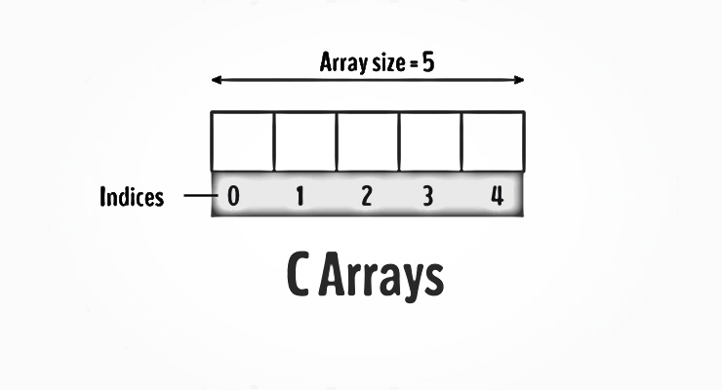
Intro
Variable
DS
Fixed Size
Sequential
Collection of elements of same type.
Collection of Variables
Num1, Num2, Num3… → num[0], num[1], num[2],…

Slide 3
Syntax
data_type variable_name[size];
int num[10];

Slide 4
int num[10];
num[3]
num[1]
num[0]
num[2]
int num[5] = {11,12,13,14,15}
11 | 12 | 13 | 14 | 15

Slide 5
How to Change the value of an array?
int mark[5] = {19, 10, 8, 17, 9} // make the value of the third element to -1 mark[2] = -1; // make the value of the fifth element to 0 mark[4] = 0;

Slide 6
Input and Output
// take input and store it in the 3rd element ​scanf("%d", &mark[2]); // take input and store it in the ith element scanf("%d", &mark[i-1]);
// print the first element of the array printf("%d", mark[0]);

Slide 7
Ex-1: Program to take 5 values from users and store them in an array
int i, num[5];
printf(“Enter 5 numbers\n”);
for( i=0; i <5 ; i++){
scanf(“%d”, &num[i]);
}
for( i=0; i <5 ; i++){
printf(“%d\n”, num[i]);
}
Enter 5 integers: 1
-3
34
0
3
Displaying integers: 1
-3
34
0
3

Slide 8
// Program to find the average of n numbers using arrays
#include <stdio.h>
int main() {
int marks[10], i, n, sum = 0;
double average;
printf("Enter number of elements: ");
scanf("%d", &n);
for(i=0; i < n; ++i) {
printf("Enter number%d: ",i+1);
scanf("%d", &marks[i]);
// adding integers entered by the user to the sum variable
sum += marks[i];
}
// explicitly convert sum to double
// then calculate average
average = (double) sum / n;
printf("Average = %.2lf", average);
return 0; }
Enter number of elements: 5
Enter number1: 45
Enter number2: 35
Enter number3: 38
Enter number4: 31
Enter number5: 49
Average = 39.60

Slide 9
Practice
https://www.w3resource.com/c-programming-exercises/array/index.php
Write a program in C to read n number of values in an array and display them in reverse order.
Write a program in C to find the sum of all elements of the array.
Write a program in C to copy the elements of one array into another array.
Write a program in C to count the total number of duplicate elements in an array.
Write a c program to sort an array
Write a program in C to find the maximum and minimum elements in an array.

